Slide 1
BCA CAPSTONE PROJECT (Review III) Vaskparg (Community App)
Submitted to the Presidency University, Bengaluru in partial fulfillment for the award of the degree of Bachelor of Computer Applications(BCA)
Project Team No : 77
Under the supervision of
Mr S. Shakti Sir Assistant Professor , School of Information Science
Name | Roll Number
Aswin P V | 20231bcd0003
Keneilhounuo Sanchu | 20231bcd0013
Ghan Shyam Pal | 20231bcd0052
Rishita Kumari | 20231bcd0058

Slide 2
Content
Project Overview
Modular design
Timeline of the Project
Github Link
Team Member Contributions
Future scope

Slide 3
Project Overview
Restate the Project Goal/Problem:
Many existing community apps are cluttered and hard to use.
This creates barriers to effective communication and engagement.
VASKPARG aims to solve this by offering a simple, organized, and user-friendly platform
Review the Scope:
The project aims to develop a user-friendly mobile app for community interaction.
It will focus on communication, content sharing, and event coordination.
The scope is limited to core features needed for effective and organized engagement

Slide 4
Module Design
Modular Breakdown
Module 1: (e.g., Data Collection) :
Functionality: Enables users to securely register and access the app. Includes features like sign-up, login, password recovery, and user session management.
Importance : Ensure secure access and personalized user experience.
Status: Completed

Slide 5
Module Design(Contd)
Module 2: Community Feed & Content Sharing
Functionality : The community feed in apps displays real-time updates like posts, announcements, and shared content from members, enabling interaction via likes, comments, and shares. It supports multimedia uploads and personalized content filtering to enhance user engagement.
Importance : The feed fosters community engagement by providing a dynamic space for sharing ideas and updates.
Status: Completed

Slide 6
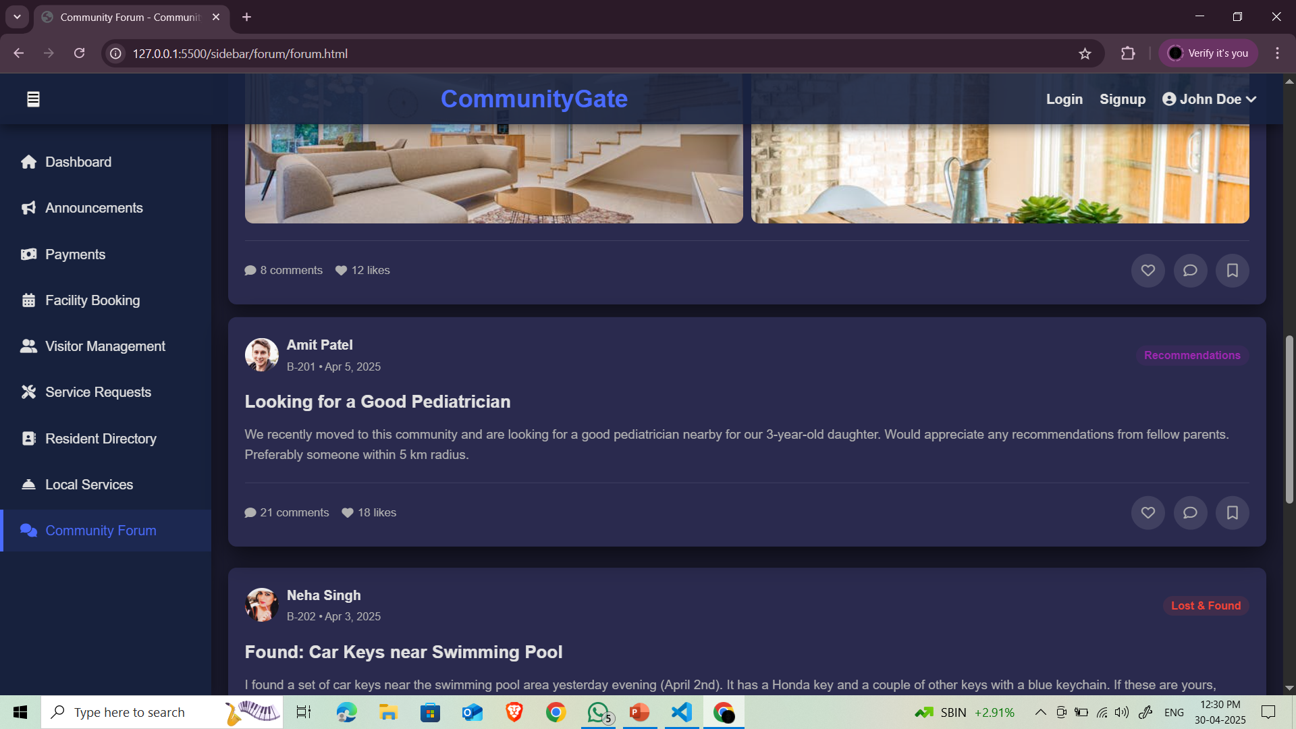

Slide 7
Module Design(Contd)
Module 3 Event Coordination
Functionality: Event coordination in community apps streamlines organizing, promoting, and managing events like meetups or webinars. Features include registration, attendee tracking, push notifications, and communication tools to boost engagement.
Importance: Allows users to create, manage, and join community events. Enhances engagement and streamlines event planning.
Status: Completed

Slide 8
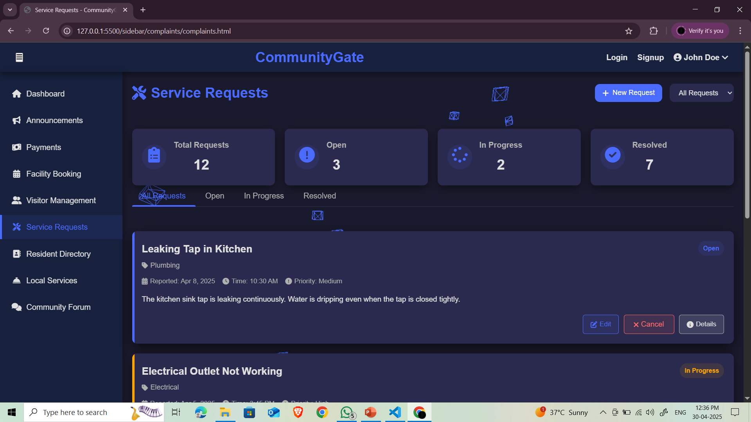

Slide 9
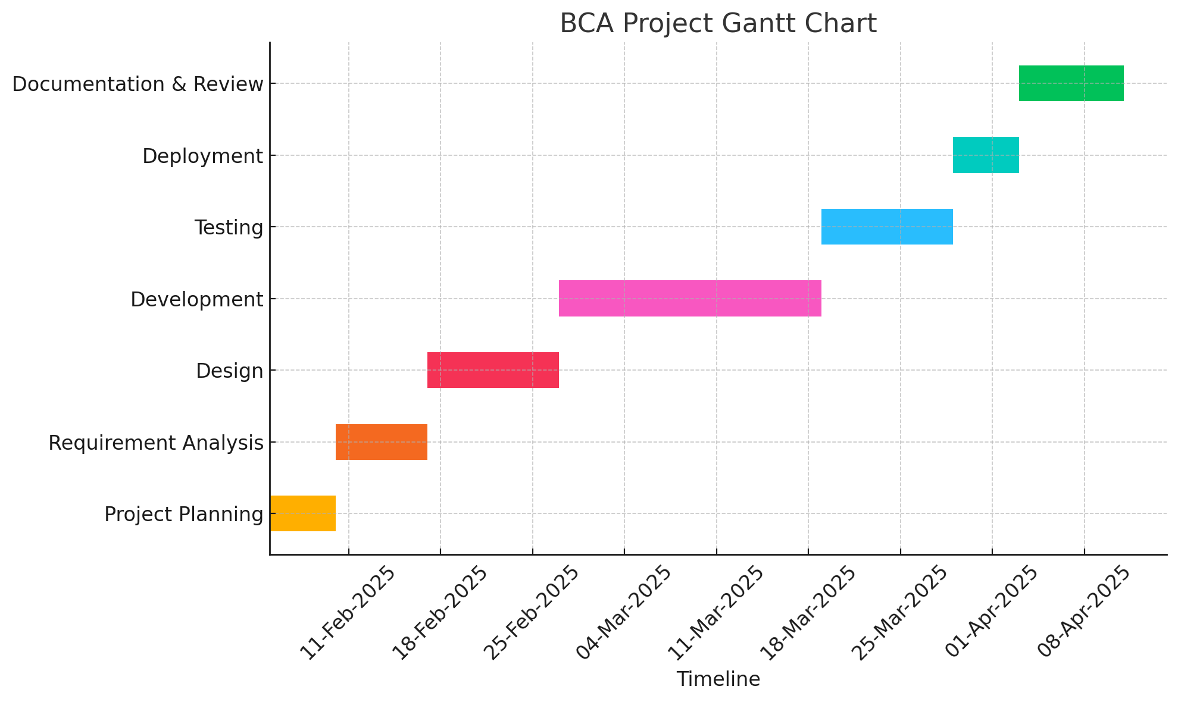
Timeline of the Project (Gantt Chart)

Slide 10
Github Link
Github Link
https://github.com/Vaskparg

Slide 11
Team Member Contributions
Team Member | Contribution
Ghan Shyam Pal | Frontend of the project
Rishita Kumari | Backend
Keneilhounou Sanchu | Data Base
Aswin P V | Testing and Integration

Slide 12
Future Scope
The Community App has strong potential for future growth and enhancement. Real-time chat and event features can be added to boost user interaction, while location-based services can help users connect with nearby events and members. Integration of AI will enable personalized content and smarter recommendations, and machine learning can provide insights into community behavior for ongoing improvements.. As the user base grows, the system can be scaled to maintain performance and reliability.
Enhancing the app’s design and interface will improve accessibility across all age groups and devices. Adding multilingual support can foster greater inclusivity within diverse communities. The platform also holds academic value, providing data for research into digital communities and social interaction.

Slide 13


